Slide 1

Duvet Business

Slide 2


Who we are
John Doe
Jane Doe
Co-Founder
MBA, BFA
[claim to fame]
Co-Founder
MBA, BFA
[claim to fame]

Slide 3

Duvet Business is a global provider of customized designs for your bedding needs

Slide 4




We believe we are creating a unique product that allows you to
tune your room to your personality

Slide 5

Our Mission
Transforming the intangible to tangible

Slide 6
Market trends are in our favor
Health Consciousness
Personal Expression
Small Luxuries
2014
2015
2016
2014
2015
2016
2014
2015
2016

Slide 7
Our results: rapid adoption, growth and profitability
Repeat Order Rate
Active Customers
Annual Revenue
Financial analysis from http://www.corporatefinanceinstitute.com

Slide 8

“When I go to sleep each night I feel truly at peace, all wrapped up in a duvet that I designed.”
- Loyal Customer
Notes:
Slide 11

Slide 9

Our Business

Slide 10

Our business model is unique
Delivery
Creativity in your home
Buyer
Looks for unique products for their home
Product
Creativity in their hands
Platform
The place to find the comfort of your dreams
Images from istockphoto.com
Notes:
Slide 12

Slide 11
Our customers are clearly defined
Young adults with good taste
Finally able to pay their own rent, the young adult will want to customize everything!
Avg. Age
Avg. Disposable income
29
$16,427
27
$19,612
35
$22,128
Cool moms
Looking for an original gift for her children.
Airbnb home owners
Wanting to provide a state of the art environment to their customers.
Notes:
Slide 15

Slide 12

Our channels are optimized
Email
40%
Paid search
10%
Organic search 50%

Slide 13
And customers keep coming back
830K
1.1M
1.4M
2014
2015
2016

Slide 14
“I searched high and low for the perfect duvet… and finally found it by designing my own at Duvet Business. Beyond satisfied!”
- Satisfied Customer

Slide 15

The Path Forward

Slide 16




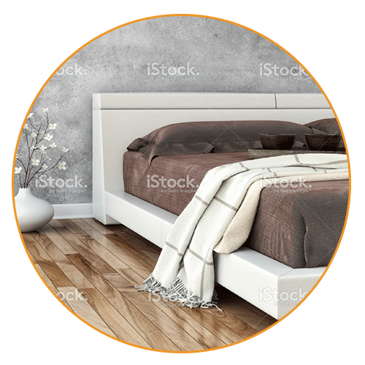
We are just getting started
Country Expansion
U.K.
China
Brazil
Product Expansion
Duvets
Accessories
Interior Design
Customer Experience
We will ask you questions to tailor your search
Images from istockphotos.com

Slide 17
Product expansion: providing our customers with…
Duvets
Accessories
Interior design
Our business model is scalable:
We let our customers’ imagination run free

Slide 18
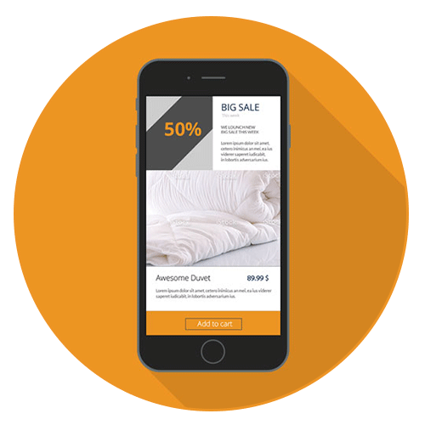
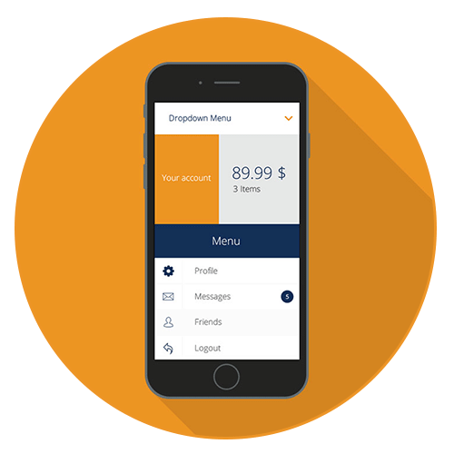
Enhancing the customer experience
Differentiated experiences for different people
Images and mockups from istockphotos.com and graphberry.com

Slide 19

Our Financials

Slide 20
We are experiencing consistent revenue growth trends

Slide 21
And our EBITDA margins are very healthy
18%
10%
2014
2016

Slide 22
Which ultimately drives long term value creation
Revenue
Gross Profit
Marketing
Product development
General and Administrative
Adjusted EBITDA
EBIT
Historical
Long Term Model*
100%
50% - 52%
15% - 16%
15% - 17%
9% - 11%
18% - 21%
7% - 10%
2014
100%
62%
15%
20%
29%
10%
(2)%
2015
100%
65%
14%
21%
25%
16%
5%
2016
100%
67%
14%
22%
24%
18%
7%
*Financial model from http://www.corporatefinanceinstitute.com

Slide 23
“I truly feel at home when I enter my room and my duvet reminds me of who I am.”
- Satisfied customer

